Slide 1

Designing CNN for Optical Character Recognition
Sandesh Kumar-1973056
Faisal Gul - 1950572

Slide 2



Popular challenge in Computer Vision
What is Optical Character Recognition (OCR)
Optical Character Recognition (OCR) is the process of detecting and reading text in images
Handwritten OCR can work with characters captured at various angles and shapes

Slide 3
Build an OCR system by implementing a CNN architecture to distinguish between handwritten letters from the EMNIST Letters dataset.
AIM of the Project
Evaluate CNN model on handwritten letters captured by camera.

Slide 4

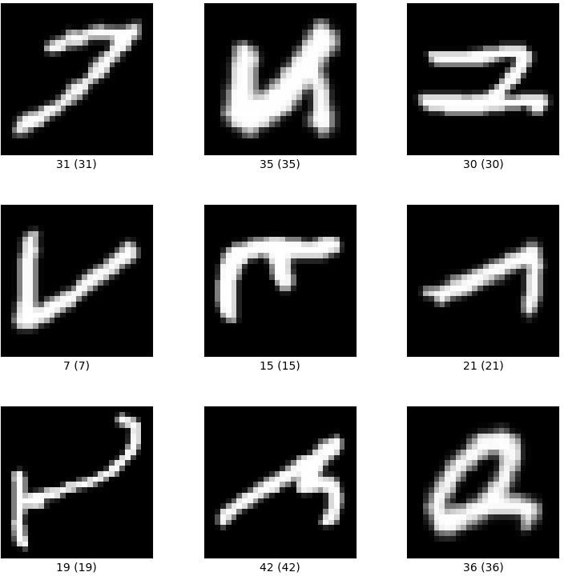


What is EMNIST Dataset
EMNIST dataset is a set of handwritten character digits derived from the NIST Special Database 19 and converted to a 28x28 pixel image format.
It consists of a set of upper- and lowercase letters, categorized into 26 classes.
The dataset is balanced.

Slide 5
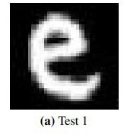
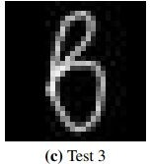
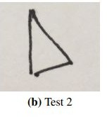
Test datasets
1
2
3
6.000 images from EMNIST Letters
52 Handwritten letters captured by camera
52 letters drawn with the use of Tkinter user interface

Slide 6

Loading EMNIST data
def load_data(path="emnist_matlab.npz", type="letters"):
# Log about loading logging.basicConfig(level=logging.INFO) logging.info('Loading dataset = emnist')
Vast amount of data in EMNIST
# Load data
path = get_file(
path, origin=("http://www.itl.nist.gov/iaui/vip/cs_links/EMNIST/" "matlab.zip")
with ZipFile(path, "r") as opened_zip:
)
Download from NIST site as a zipped MATLAB ﬁle
# Read file and temporarily store it
file_name = f"./{type}.mat" f = open(file_name, "wb")
f.write(opened_zip.read(f"matlab/emnist-{type}.mat")) f.close()
# Load data from Matlab file.
# Source: https://stackoverflow.com/a/53547262
Temporarily whole dataset stored
mat = sio.loadmat(file_name)
data = mat["dataset"]
input_train = data["train"][0, 0]["images"][0, 0]
target_train = data["train"][0, 0]["labels"][0, 0].flatten()
input_test = data["test"][0, 0]["images"][0, 0]
target_test = data["test"][0, 0]["labels"][0, 0].flatten()
Needed data pulled out, rest out of memory
# Remove data when loaded
os.remove(file_name)

Slide 7

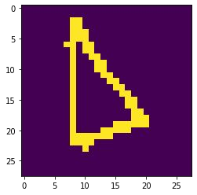
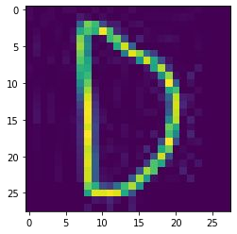
Preprocessing image data
EMNIST data
loaded from site
Camera data
loaded from drive
Tkinter data
loaded from drive
Divide in sets
train
validation
test 1
Threshold image
empirically determined
downscale to 28x28 greyscale
Image.open(infilename)
ImageOps.grayscale(img) img_gray.resize((28, 28), Image.ANTIALIAS)
1D into 28x28 2D array
normalization
pixels = pixels/ 255.0
data.reshape( (data.shape[0], 28, 28), order='F')
adjust dimensionality of data
data.reshape(#images, 1, 28, 28)
convert to pytorch tensors
torch.from_numpy(data).type(torch.float)

Slide 8
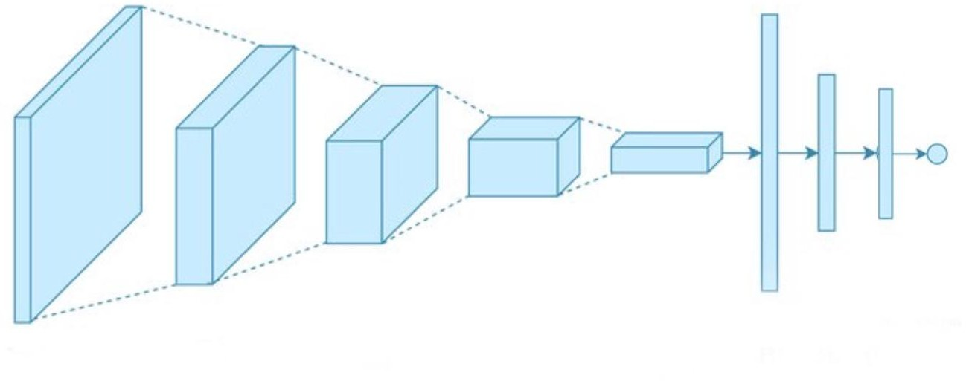
Model architecture
Input 28x28x1
Convolution 1 24x24x16
Max Pooling 1 12x12x16
Convolution 2 8x8x32
Max Pooling 2 4x4x32
Output
FC1 512
FC2 128
FC3
Number of classes

Slide 9
Model architecture

Slide 10
Evaluation of the model using test statistics
Botlab 99.2%
Peng and Yin 88.77%-99.75%
Test set number & sample size | Accuracy |  | F1 score | Precision score | Recall score
1 (6000) EMNIST letters | 0.92 |  | 0.91 | 0.92 | 0.92
2 (52) Camera captured | 0.87 |  | 0.86 | 0.89 | 0.87
3 (52) Tk UI | 0.88 |  | 0.88 | 0.92 | 0.88

Slide 11

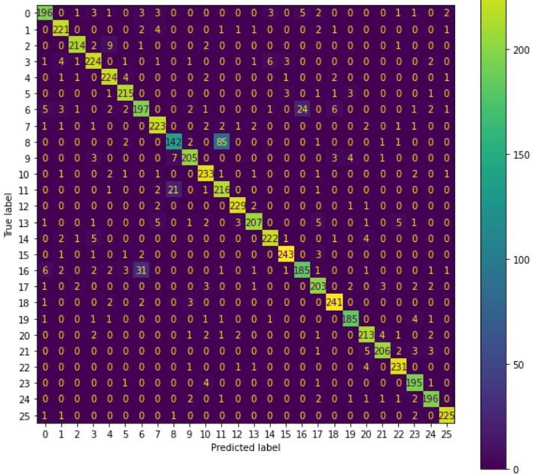
Confusion Matrix Test 1
# of mislabeled cases | Letter 1 | Letter 2
106 | I | L
55 | G | Q

Slide 12
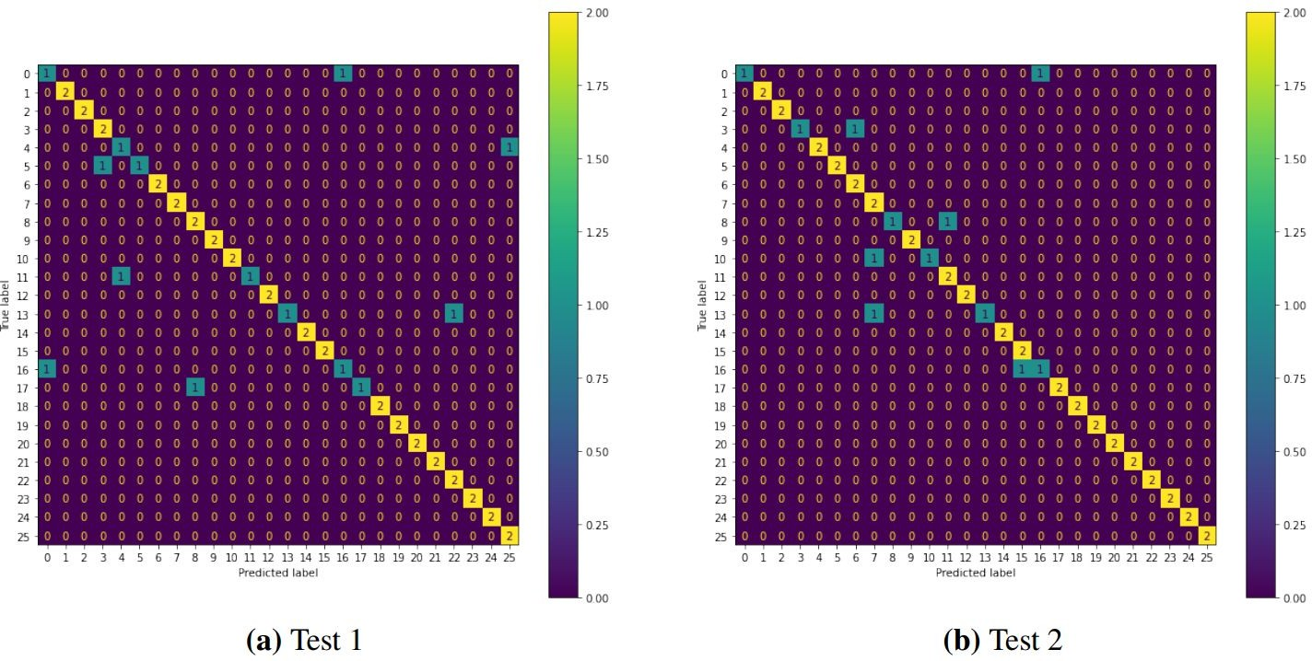
Confusion Matrix Test 2 and Test 3
Mislabeling of A and Q letters together having 3 wrong predictions out of 8

Slide 13



Limitations and Challenges
The EMNIST Letters dataset is too big, therefore, we used only its part. But we still achieved validation accuracy of 92 %
Test 2 images were captured by camera during daylight. But when we ran model on more dark images, model performance was poor
The model generally does not show good performance on some images, because they are very different from EMNIST data

Slide 14
Conclusion
Automatic recognition of handwritten letters, captured by camera, can be implemented using the Pytorch CNN framework and showed an accuracy of 87%

